Slide 1

Image Recognition

Slide 2

TABLE OF CONTENTS
01
02
03
04
DIGITAL
IMAGE
IMAGE
RECOGNITION
Teachable
machine
Q&A

Slide 3

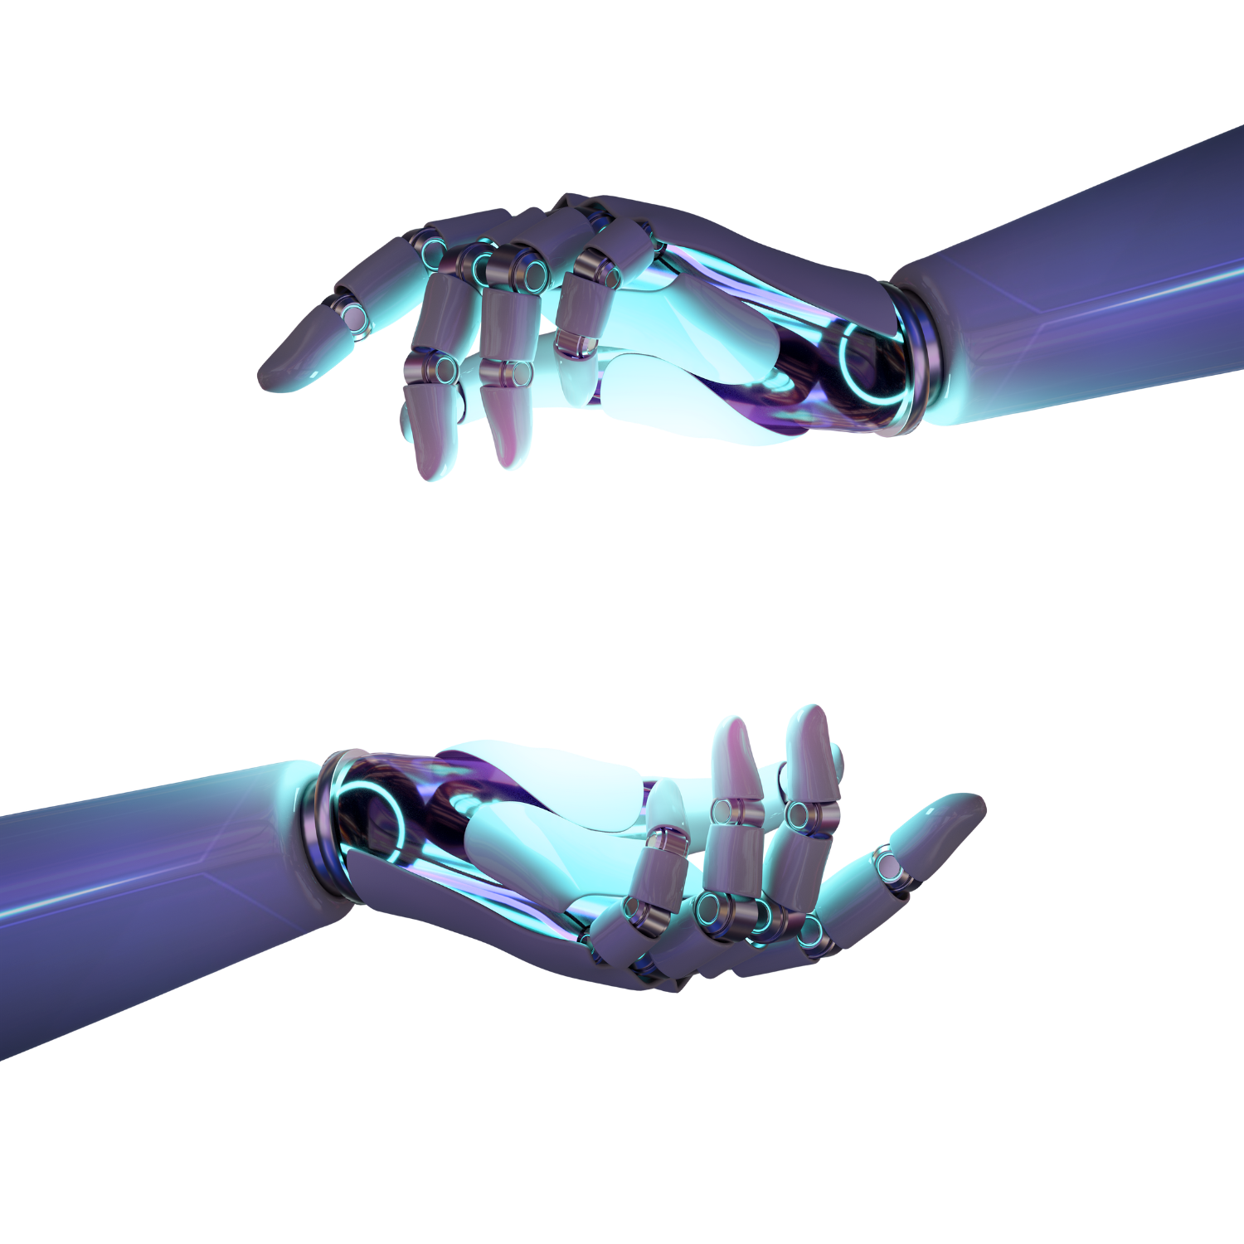


01
Digital Image

Slide 4



What do you see?

Slide 5

What do you see?

Slide 6

What do you see?

Slide 7
How Does the Machine See Images?

Slide 8
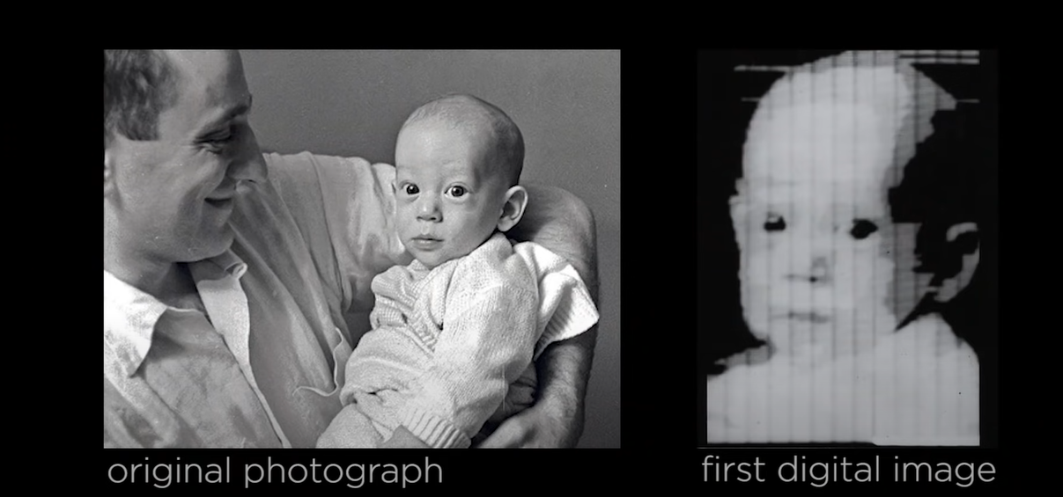
How Does the Machine See Images?

Slide 9
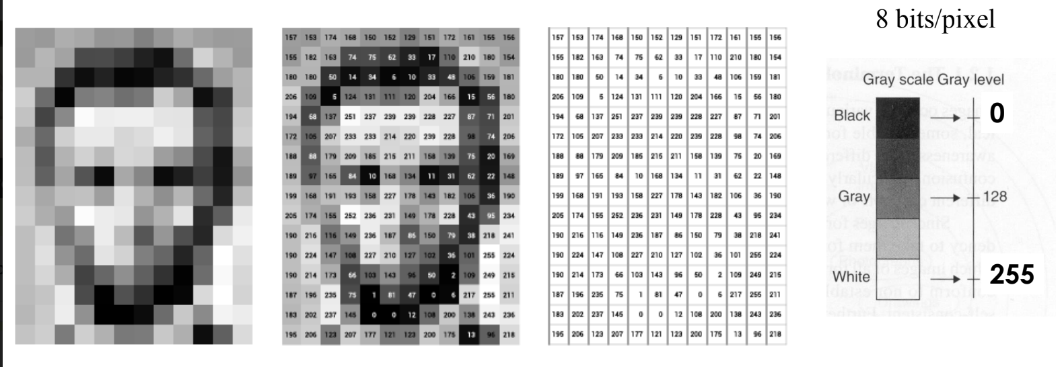
How Does the Machine See Images?
A digital image is an image composed of pixels.
the computer sees an image as numerical values of these pixels.

Slide 10

How Does the Machine See Images?

Slide 11
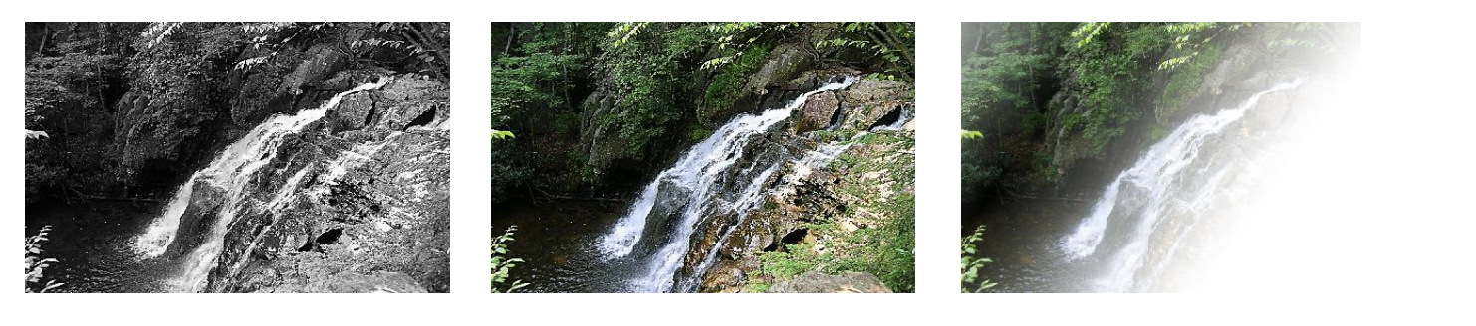
Common image formats
(B&W or Grayscale)
(Red, Green, and Blue)
point (Red, Green, Blue, and “Alpha”, a.k.a. Opacity)

Slide 12
5 min BREAK

Slide 13
02
Image recognition

Slide 14
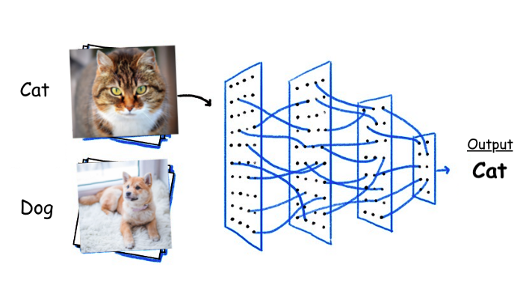
Image recognition
refers to technologies that identify places, logos, people, objects, buildings, and several other variables in digital images.

Slide 15
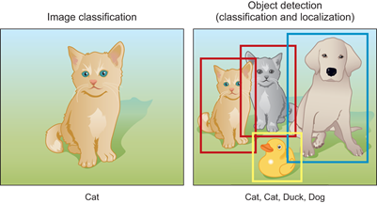

VS
IMAGE RECOGNITION
OBJECT DETECTION
Image classification involves predicting the class of one object in an image
Object detection combines these two tasks and localizes and classifies one or more objects in an image.

Slide 16
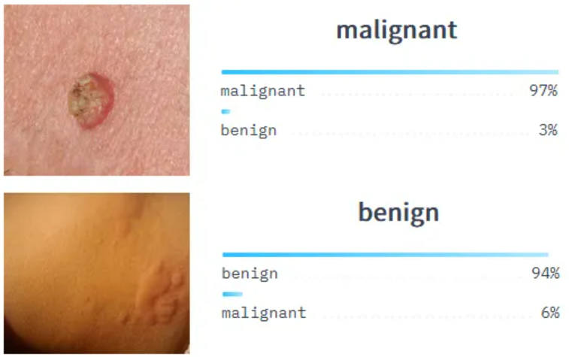
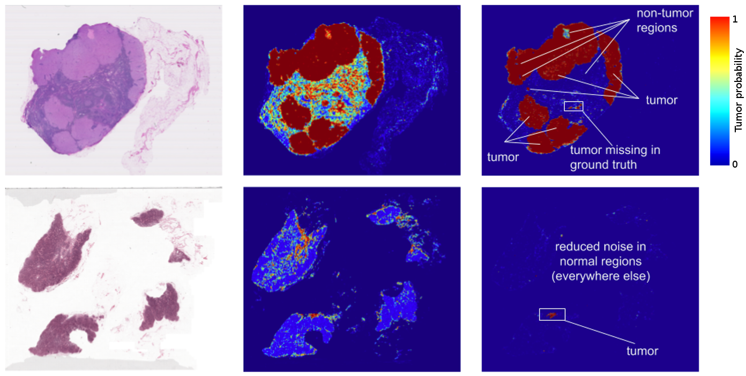
Image recognition in our life
Classification of skin cancer
Detection of cancer cells in pathology slides

Slide 17
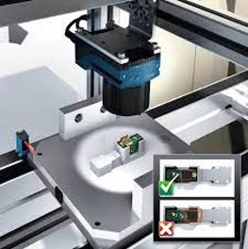
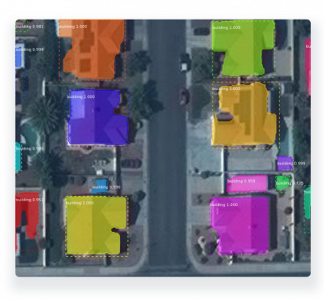
Image recognition in our life
Land use mapping
Automated inspection and quality control

Slide 18
03
Teachable machine
https://teachablemachine.withgoogle.com

Slide 19
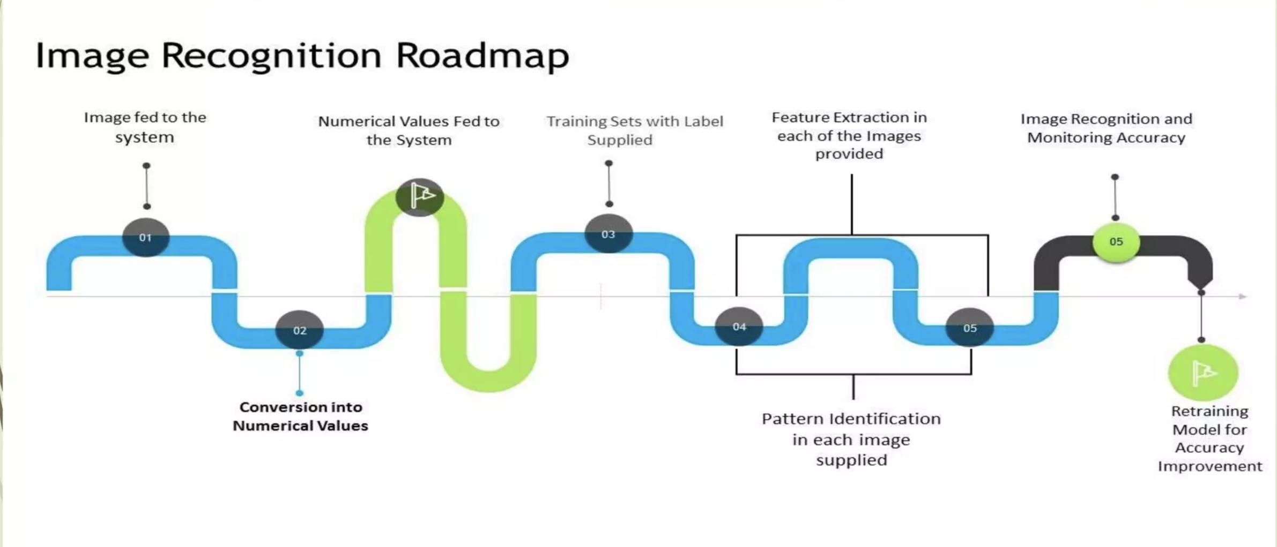
STEPS

Slide 20
Q&A
?
?
?

Slide 21

Attendees
https://forms.office.com/r/CiiXEYx4R1

Slide 22
THANK YOU!!

Slide 23
References
https://medium.com/analytics-vidhya/image-classification-techniques-83fd87011cac
https://www.mygreatlearning.com/blog/image-recognition/
https://www.javatpoint.com/object-recognition-using-python
https://www.fritz.ai/object-detection/
https://www.g2.com/articles/object-detection
https://youtu.be/15aqFQQVBWU

Slide 24
03
OBJECT DETECTION

Slide 25
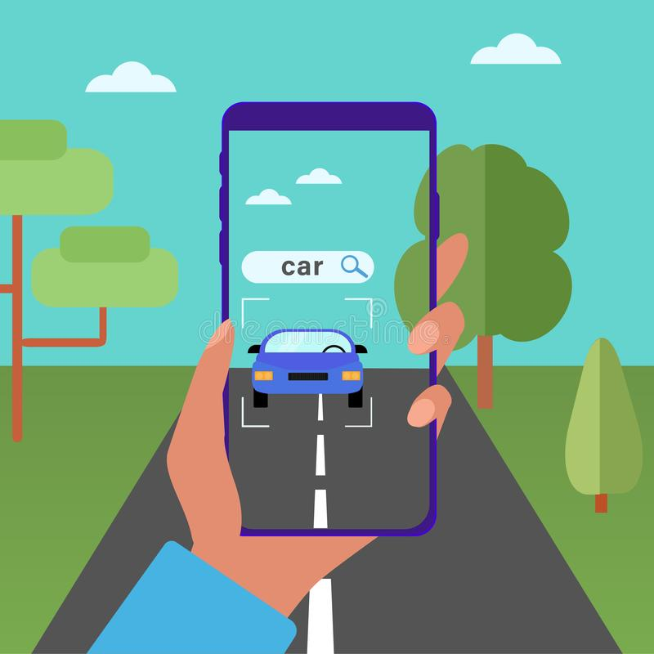
What is Object Detection
Object detection is a computer vision technique that works to identify and locate objects within an image or video. Specifically, object detection draws bounding boxes around these detected objects, which allow us to locate where said objects are in (or how they move through) a given scene.

Slide 26
Two Significant Objectives of Object Recognition
Identification of all objects that exist in an image
Filtration of the object that seeks attention

Slide 27

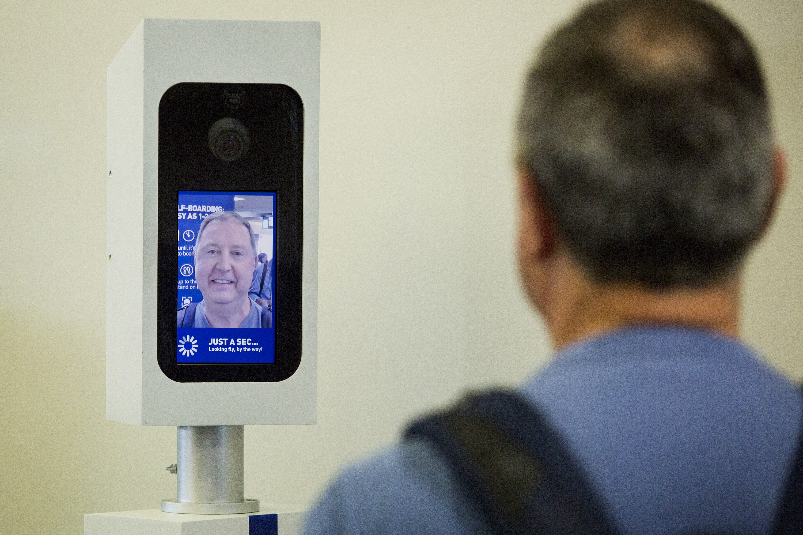
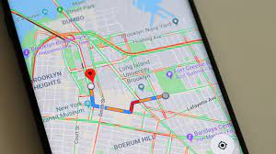
Object Detection in Our Life
Visual Product Search
Facial Recognition in airport check-in experience
Traffic Monitoring & Road Maintenance

Slide 28
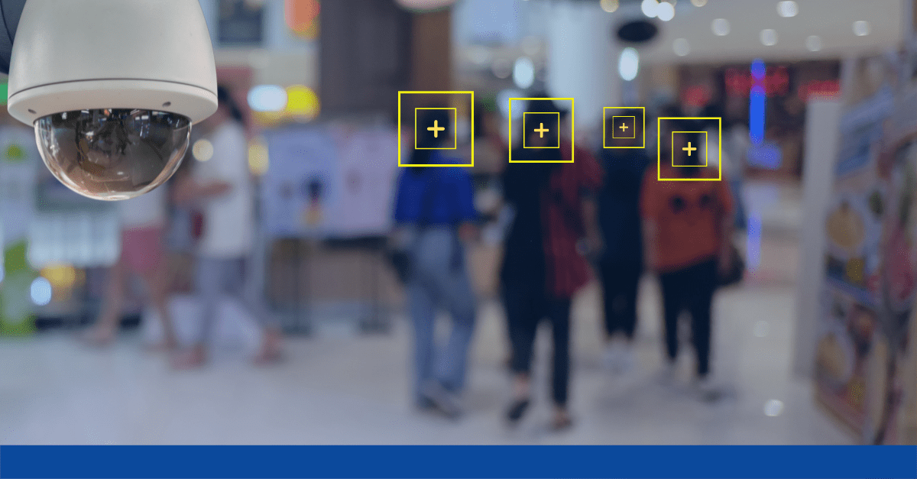
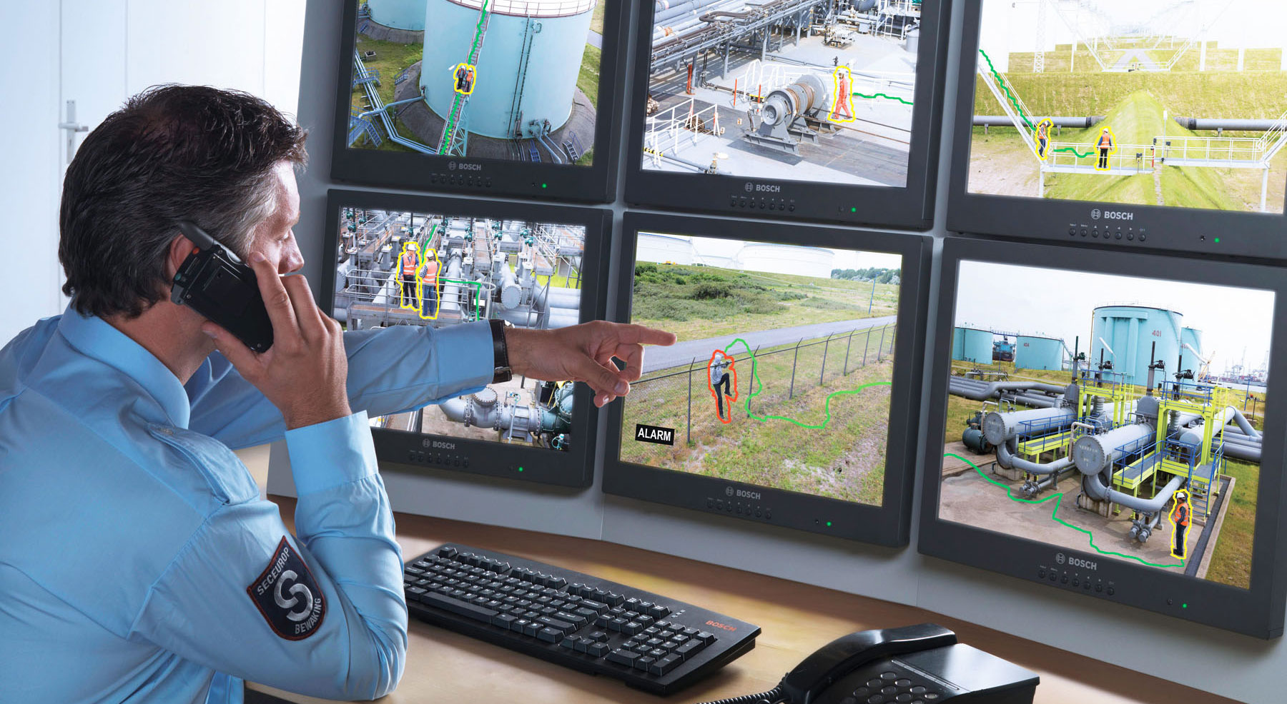
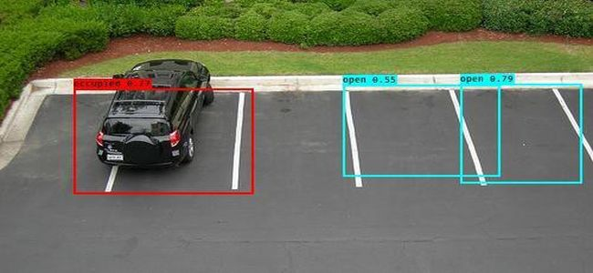
Object Detection in Our Life
People Counting
track the total number of visitors to events or public attractions for safety and planning.
Security & Safety Use Cases
CV can be deployed on surveillance systems to constantly monitor for security threats in locations
Parking system

Slide 29
Understanding the ImageAI Library
ImageAI makes use of several APIs that work offline - it has object detection, video detection, and object tracking APIs that can be called without accessing the Internet. ImageAI uses a pre-trained model and can easily be customized.
The ObjectDetection class of the ImageAI library consists of methods to perform object detection on any image or set of images with the help of pre-trained models. With ImageAI, we can detect and recognize eighty distinct types of common, everyday objects.

